Slide 1
Making Decisions using if-else statements
Course Code: CSC1102 &1103
Course Title: Introduction to Programming
Dept. of Computer Science
Faculty of Science and Technology
Lecturer No: | 3 | Week No: | 2 (2X1.5 hrs) | Semester:
Lecturer: | Syeda Nishat Tasnim(nishat@aiub.edu)

Slide 2
Lecture 3: Outline
Making Decisions
The if Statement
The if-else Construct
Logical Operators
Boolean Variables
Nested if Statements
The else if Construct
The switch Statement
The Conditional Operator
Character Input/Output

Slide 3
The if statement
if ( expression )
program statement
expression
If expression is true (non-zero), executes statement.
If gives you the choice of executing statement or skipping it.
no
yes
Program statement

Slide 4
Example - if
// Program to calculate the absolute value of an integer
int main (void)
{
int number;
cout<<"Type in your number: “<<endl;
cin>>number;
if ( number < 0 )
number = -number;
cout<<"The absolute value is “<<number<<endl;
return 0;
}

Slide 5
The if-else statement
if ( expression )
program statement 1
else
program statement 2
if-else statement: enables you to choose between two statements
expression
yes
no
Program statement 1
Program statement 2

Slide 6
Example: if-else
// Program to determine if a number is even or odd
int main ()
{
int number_to_test, remainder;
cout<<“Enter your number to be tested: ”<<endl;
cin>>number_to_tes;
remainder = number_to_test % 2;
if ( remainder == 0 )
cout<<"The number is even“<<endl;
else
cout<<"The number is odd“<<endl;
return 0;
}

Slide 7
Example: compound relational test
/* Program to determine if a number is even or odd
and also the number cannot be negative */
int main ()
{
int number_to_test, remainder;
cout<<“Enter your number to be tested: ”<<endl;
cin>>number_to_tes;
remainder = number_to_test % 2;
if (number_to_test >= 0 && remainder == 0 )
cout<<"The number is even“<<endl;
else
cout<<"The number is odd“<<endl;
return 0;
}

Slide 8
Logical operators
Operator | Symbol | Meaning
AND | && | X && y is true if BOTH x and y are true
OR | || | X || y is true if at least one of x and y is true
NOT | ! | !x is true if x is false
Logical values as operands or in tests: true = non-zero, false=zero
Logical values returned as results of expressions: true = 1, false=zero
Example: 5 || 0 is 1

Slide 9
Precedence of operators
Precedence
!, ++, --, (type)
*, /, %
+, -
<, <=, >, >=, ==, !=
&&
||
=
Example for operator precedence:
a > b && b > c || b > d
Is equivalent to:
((a > b) && (b > c)) || (b > d)

Slide 10
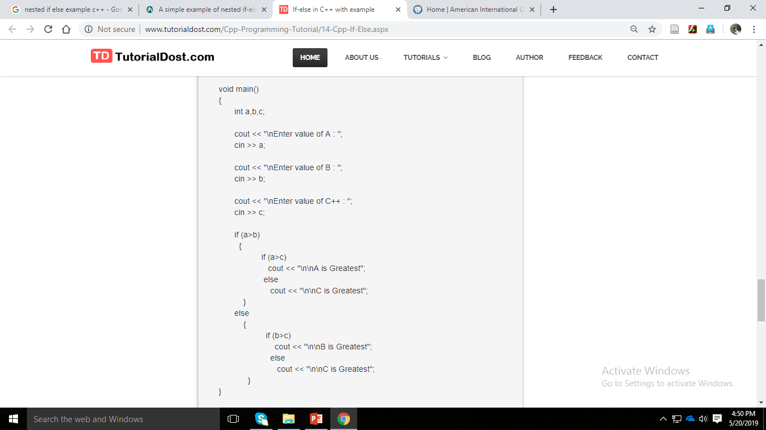
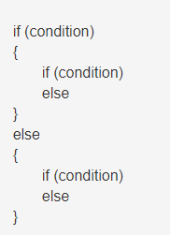
Nested if statements

Slide 11
Multiple choices – else-if
int number;
if ( expression 1)
program statement 1
else if ( expression 2)
program statement 2
else
program statement 3
if
negative
else
if
zero
else
Program style: this unindented formatting improves the readability of the statement and makes it
clearer that a three-way decision is being made.
positive

Slide 12
Example – multiple choices
/* Program to evaluate simple expressions of the form
number operator number */
int main () {
float value1, value2;
char operator;
cout<<“Type in your expression”<<endl;
cin>>value1>>operator>>value2;
if ( operator == '+' )
cout<<value1 + value2<<endl;
else if ( operator == '-' )
cout<<value1 - value2<<endl;
else if ( operator == '*' )
cout<<value1 * value2<<endl;
else if ( operator == '/' )
cout<<value1 / value2<<endl;
else cout<<"Unknown operator.";
return 0;
}

Slide 13
The switch statement
The expression is successively compared against the values value1, value2, ..., valuen. If a case is found whose value is equal to the value of expression, the program statements that follow the case are executed.
switch ( expression )
{
case value1:
program statement
...
break;
case value2:
program statement
...
break;
case valueN:
program statement
...
break;
default:
program statement
...
break;
}
The switch test expression must be one with an integer value (including type char) (No float !).
The case values must be integer-type constants or integer constant expressions (You can't use a variable for a case label !)

Slide 14
The switch statement (cont)
Break can miss !
Statement list on a case can miss !
switch (operator)
{
...
case '*':
case 'x':
printf ("%.2f\n", value1 * value2);
break;
...
}

Slide 15
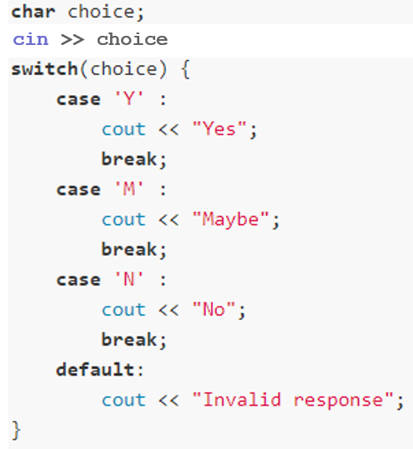
Example - switch

Slide 16
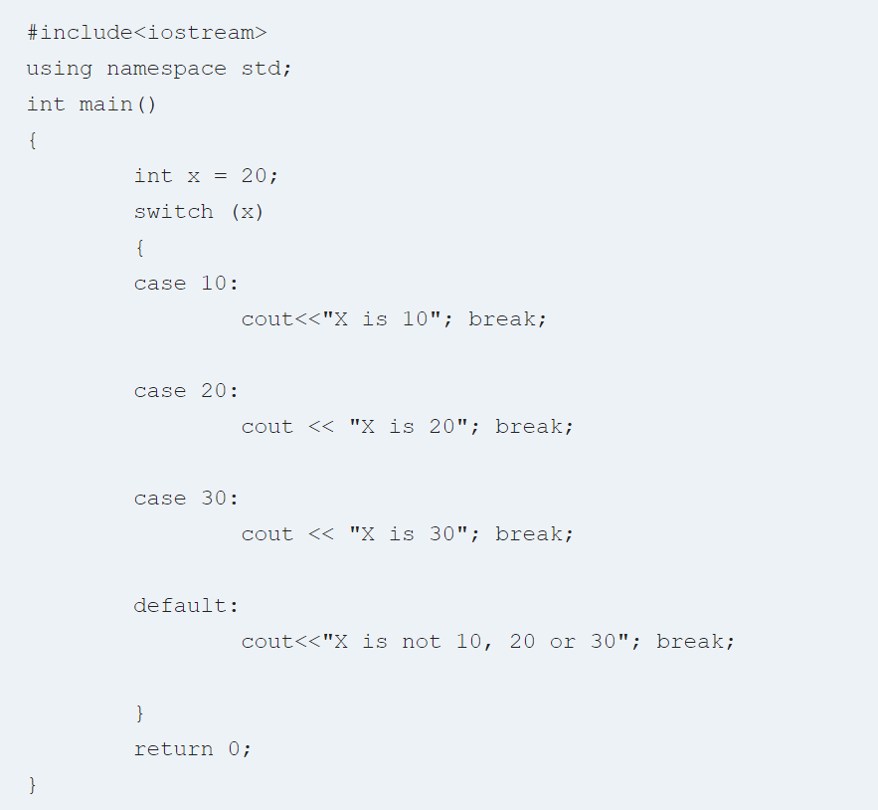
Switch

Slide 17
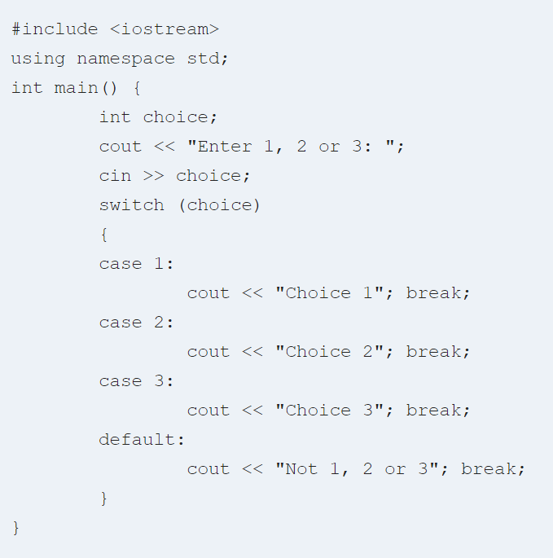
Switch

Slide 18
The conditional operator
condition ? expression1 : expression2
condition is an expression that is evaluated first.
If the result of the evaluation of condition is TRUE (nonzero), then expression1
is evaluated and the result of the evaluation becomes the result of the operation.
If condition is FALSE (zero), then expression2 is evaluated and its result
becomes the result of the operation
maxValue = ( a > b ) ? a : b;
Equivalent to:
if ( a > b )
maxValue = a;
else
maxValue = b;

